Slide 1
Chapter 9 Cluster Analysis: Advanced Methods

Slide 2
Outline
Probabilistic model-based clustering
Clustering high-dimensional data
Biclustering
Dimensionality reduction for clustering
Clustering graph and network data
Semisupervised clustering

Slide 3
Outline
Probabilistic model-based clustering
Fuzzy clusters
Probabilistic model-based clusters
Expectation-maximization (EM) algorithm
Clustering high-dimensional data
Biclustering
Dimensionality reduction for clustering
Clustering graph and network data
Semisupervised clustering

Slide 4
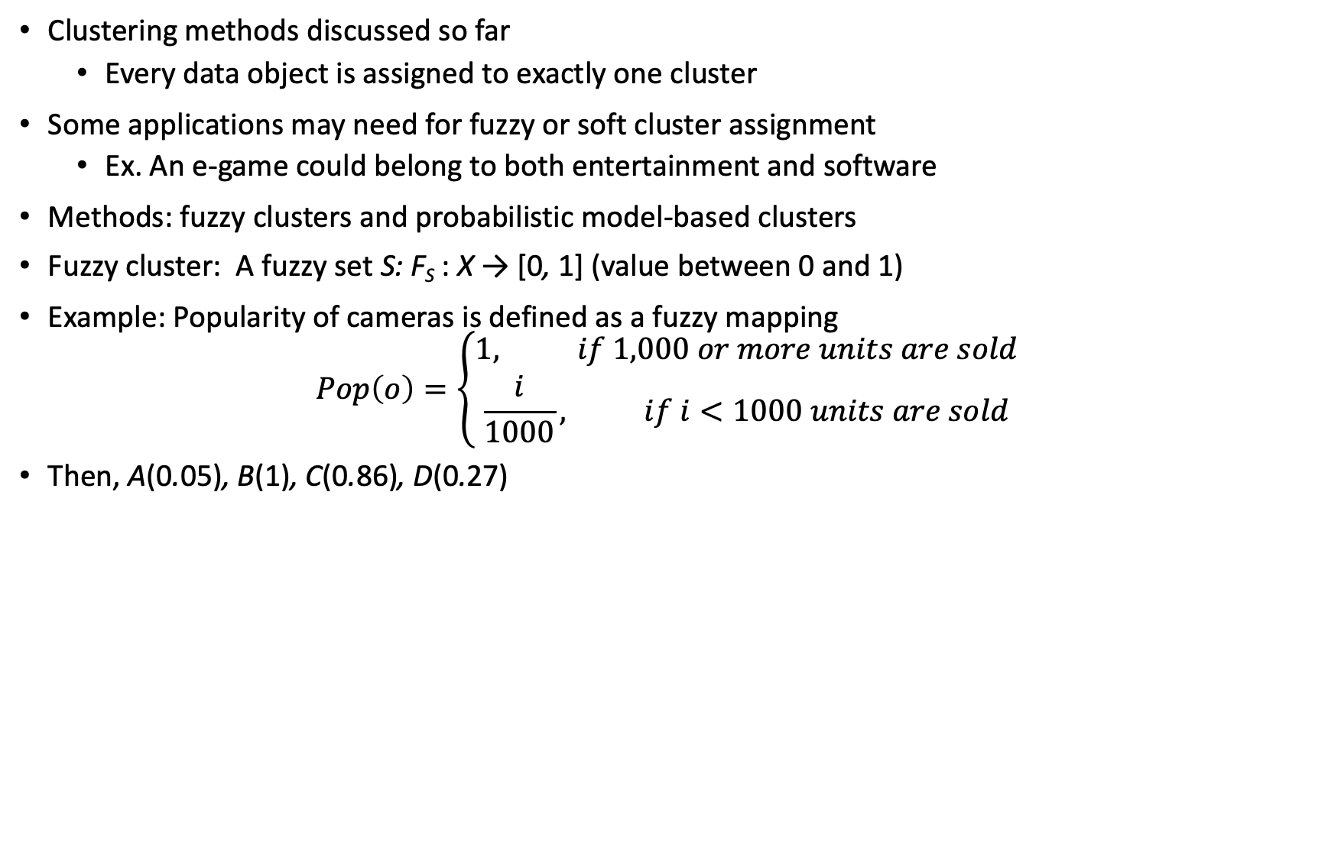
Fuzzy Set and Fuzzy Cluster
Clustering methods discussed so far
Every data object is assigned to exactly one cluster
Some applications may need for fuzzy or soft cluster assignment
Ex. An e-game could belong to both entertainment and software
Methods: fuzzy clusters and probabilistic model-based clusters
Fuzzy cluster: A fuzzy set S: F_{S} : X → [0, 1] (value between 0 and 1)
Example: Popularity of cameras is defined as a fuzzy mapping
$$Pop\left(o\right)=\left\{\begin{aligned}1, if 1,000 or more units are sold \\ \frac{i}{1000}, if i<1000 units are sold\end{aligned}\right.$$
Then, A(0.05), B(1), C(0.86), D(0.27)
4

Slide 5
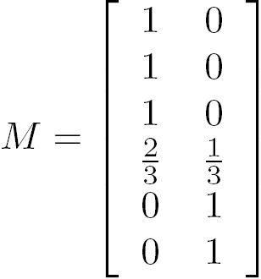
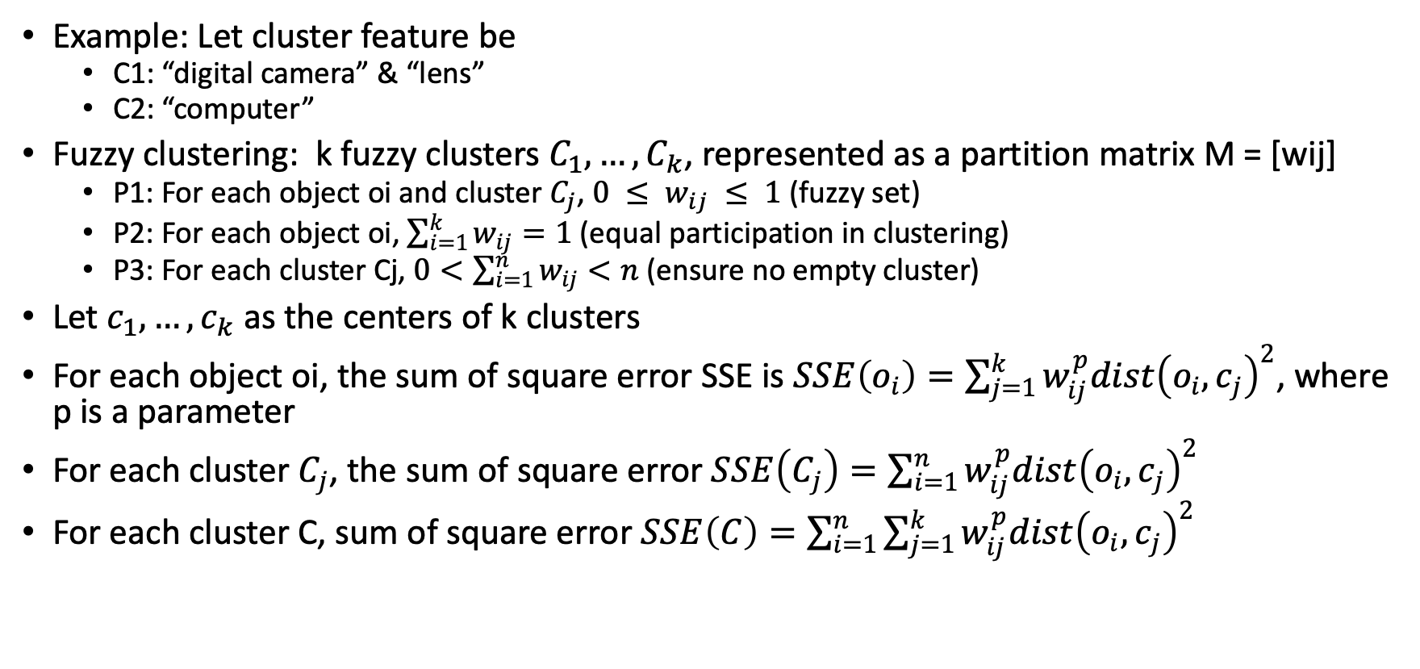
Fuzzy (Soft) Clustering
Example: Let cluster feature be
C1: “digital camera” & “lens”
C2: “computer”
Fuzzy clustering: k fuzzy clusters $C_{1}, …, C_{k}$, represented as a partition matrix M = [wij]
P1: For each object oi and cluster $C_{j}$, $0 ≤ w_{ij} ≤ 1$(fuzzy set)
P2: For each object oi, $\sum_{i=1}^{k}{w_{ij}}=1$ (equal participation in clustering)
P3: For each cluster Cj, $0<\sum_{i=1}^{n}{w_{ij}}<n$ (ensure no empty cluster)
Let $c_{1}, …, c_{k}$as the centers of k clusters
For each object oi, the sum of square error SSE is $SSE\left(o_{i}\right)=\sum_{j=1}^{k}{w_{ij}^{p}dist{\left(o_{i}, c_{j}\right)}^{2}}$, where p is a parameter
For each cluster $C_{j}$, the sum of square error $SSE\left(C_{j}\right)=\sum_{i=1}^{n}{w_{ij}^{p}dist{\left(o_{i},c_{j}\right)}^{2}}$
For each cluster C, sum of square error $SSE\left(C\right)=\sum_{i=1}^{n}{\sum_{j=1}^{k}{w_{ij}^{p}dist{\left(o_{i}, c_{j}\right)}^{2}}}$
5

Slide 6
Probabilistic Model-Based Clustering
Cluster analysis is to find hidden categories
A hidden category (i.e., probabilistic cluster) is a distribution over the data space, which can be mathematically represented using a probability density function (or distribution function)
Example: two categories for digital cameras sold
Consumer line vs. professional line
Density functions f₁, f₂ for C₁, C₂
Obtained by probabilistic clustering
6

Slide 7
Probabilistic Model-Based Clustering
A mixture model assumes that a set of observed objects is a mixture of instances from multiple probabilistic clusters, and conceptually each observed object is generated independently
Our task: infer a set of k probabilistic clusters that is mostly likely to generate D using the above data generation process
7

Slide 8
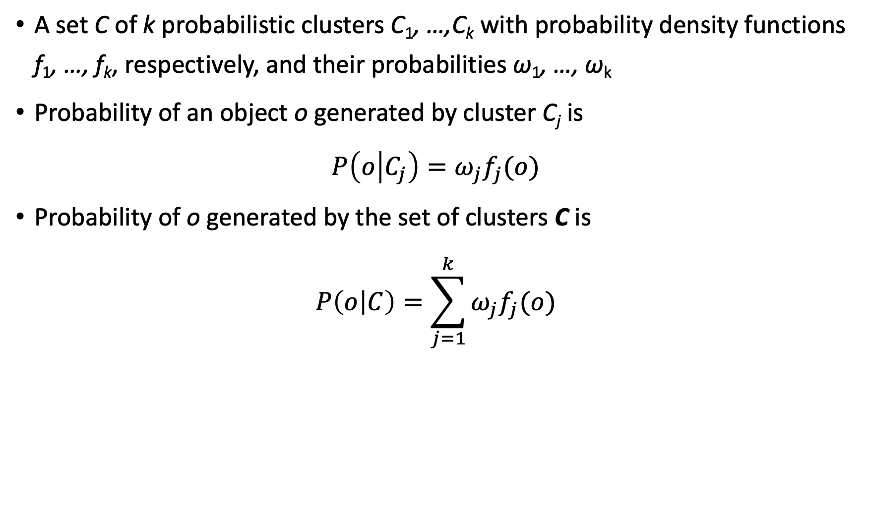
Model-Based Clustering
A set C of k probabilistic clusters C₁, …,C_{k} with probability density functions f₁, …, f_{k}, respectively, and their probabilities ω₁, …, ω_{k}
Probability of an object o generated by cluster C_{j} is
$P\left(o | C_{j}\right)=ω_{j}f_{j}(o)$
Probability of o generated by the set of clusters C is
$$P\left(o | C\right)=\sum_{j=1}^{k}{ω_{j}f_{j}(o)}$$
8
Notes:
8

Slide 9
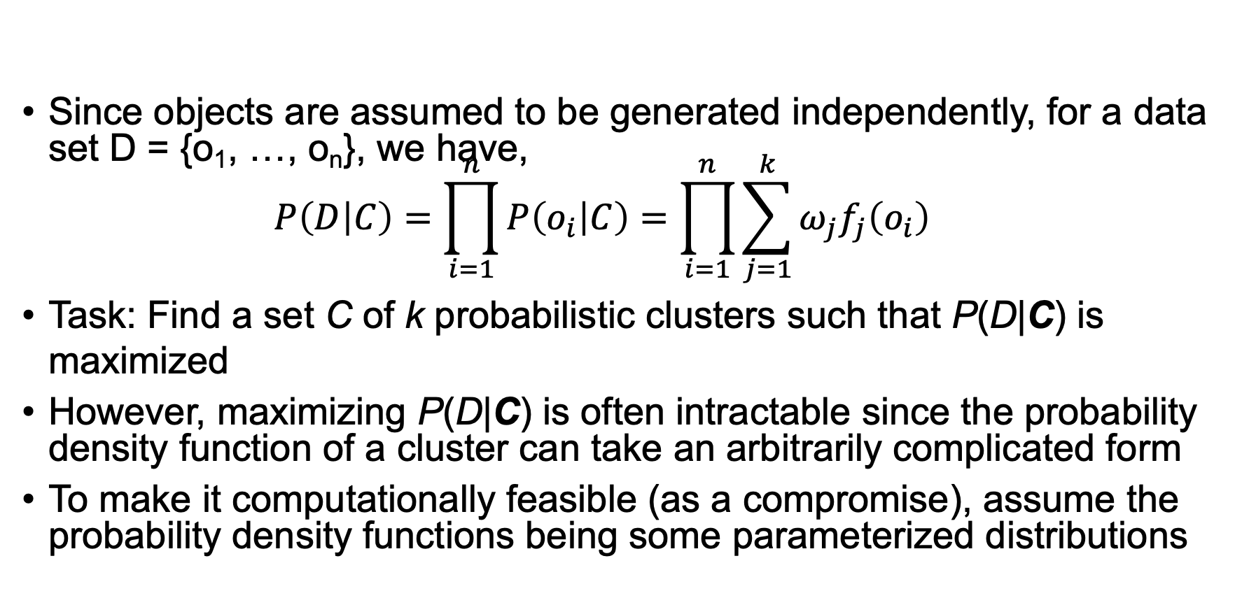
Model-Based Clustering
Since objects are assumed to be generated independently, for a data set D = {o₁, …, o_{n}}, we have, $P\left(D | C\right)=\prod_{i=1}^{n}{P\left(o_{i} | C\right)=\prod_{i=1}^{n}{\sum_{j=1}^{k}{ω_{j}f_{j}\left(o_{i}\right)}}}$
Task: Find a set C of k probabilistic clusters such that P(D|C) is maximized
However, maximizing P(D|C) is often intractable since the probability density function of a cluster can take an arbitrarily complicated form
To make it computationally feasible (as a compromise), assume the probability density functions being some parameterized distributions
9
Notes:
9

Slide 10
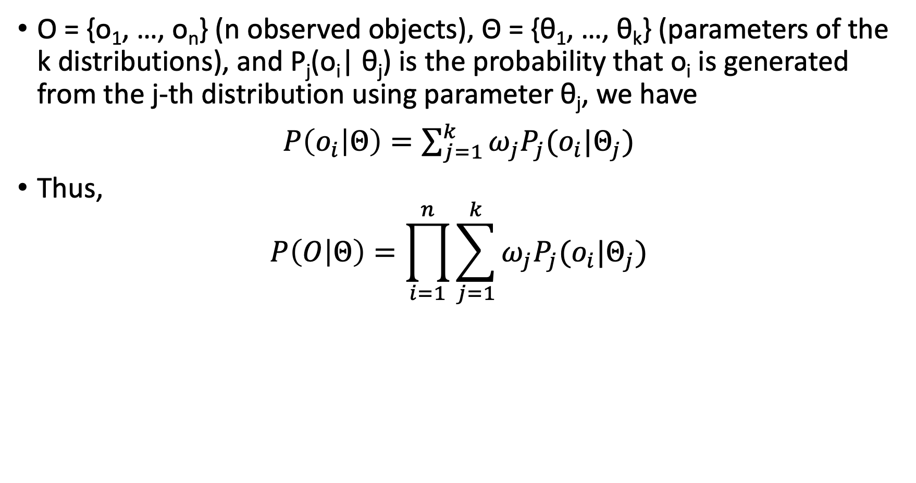
Univariate Gaussian Mixture Model
O = {o₁, …, o_{n}} (n observed objects), Θ = {θ₁, …, θ_{k}} (parameters of the k distributions), and P_{j}(o_{i}| θ_{j}) is the probability that o_{i} is generated from the j-th distribution using parameter θ_{j}, we have
$P\left(o_{i} | Θ\right)=\sum_{j=1}^{k}{ω_{j}P_{j}(o_{i}|Θ_{j})}$
Thus,
$$P\left(O | Θ\right)=\prod_{i=1}^{n}{\sum_{j=1}^{k}{ω_{j}P_{j}(o_{i}|Θ_{j})}}$$
10
Notes:
10

Slide 11
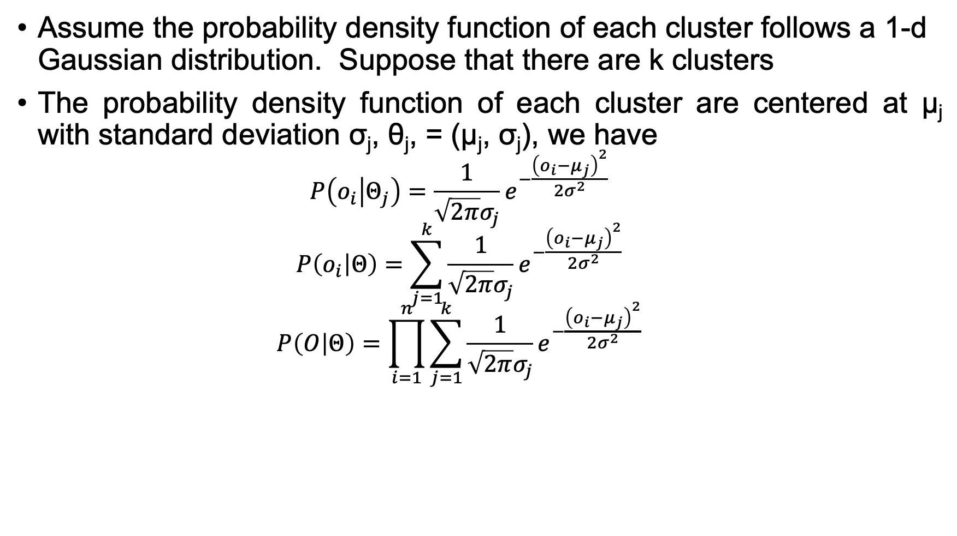
Univariate Gaussian Mixture Model
Assume the probability density function of each cluster follows a 1-d Gaussian distribution. Suppose that there are k clusters
The probability density function of each cluster are centered at μ_{j} with standard deviation σ_{j}, θ_{j}, = (μ_{j}, σ_{j}), we have
$$P\left(o_{i} | Θ_{j}\right)=\frac{1}{\sqrt{2π}σ_{j}}e^{−\frac{{\left(o_{i}−μ_{j}\right)}^{2}}{2σ^{2}}}$$
$$P\left(o_{i} | Θ\right)=\sum_{j=1}^{k}{\frac{1}{\sqrt{2π}σ_{j}}e^{−\frac{{\left(o_{i}−μ_{j}\right)}^{2}}{2σ^{2}}}}$$
$$P\left(O | Θ\right)=\prod_{i=1}^{n}{\sum_{j=1}^{k}{\frac{1}{\sqrt{2π}σ_{j}}e^{−\frac{{\left(o_{i}−μ_{j}\right)}^{2}}{2σ^{2}}}}}$$
11
Notes:
11

Slide 12
The EM (Expectation Maximization) Algorithm
The k-means algorithm has two steps at each iteration
Expectation Step (E-step): Given the current cluster centers, each object is assigned to the cluster whose center is closest to the object: An object is expected to belong to the closest cluster
Maximization Step (M-step): Given the cluster assignment, for each cluster, the algorithm adjusts the center so that the sum of distance from the objects assigned to this cluster and the new center is minimized
The (EM) algorithm: A framework to approach maximum likelihood or maximum a posteriori estimates of parameters in statistical models
E-step assigns objects to clusters according to the current fuzzy clustering or parameters of probabilistic clusters
M-step finds the new clustering or parameters that minimize the sum of squared error (SSE) or the expected likelihood
12

Slide 13
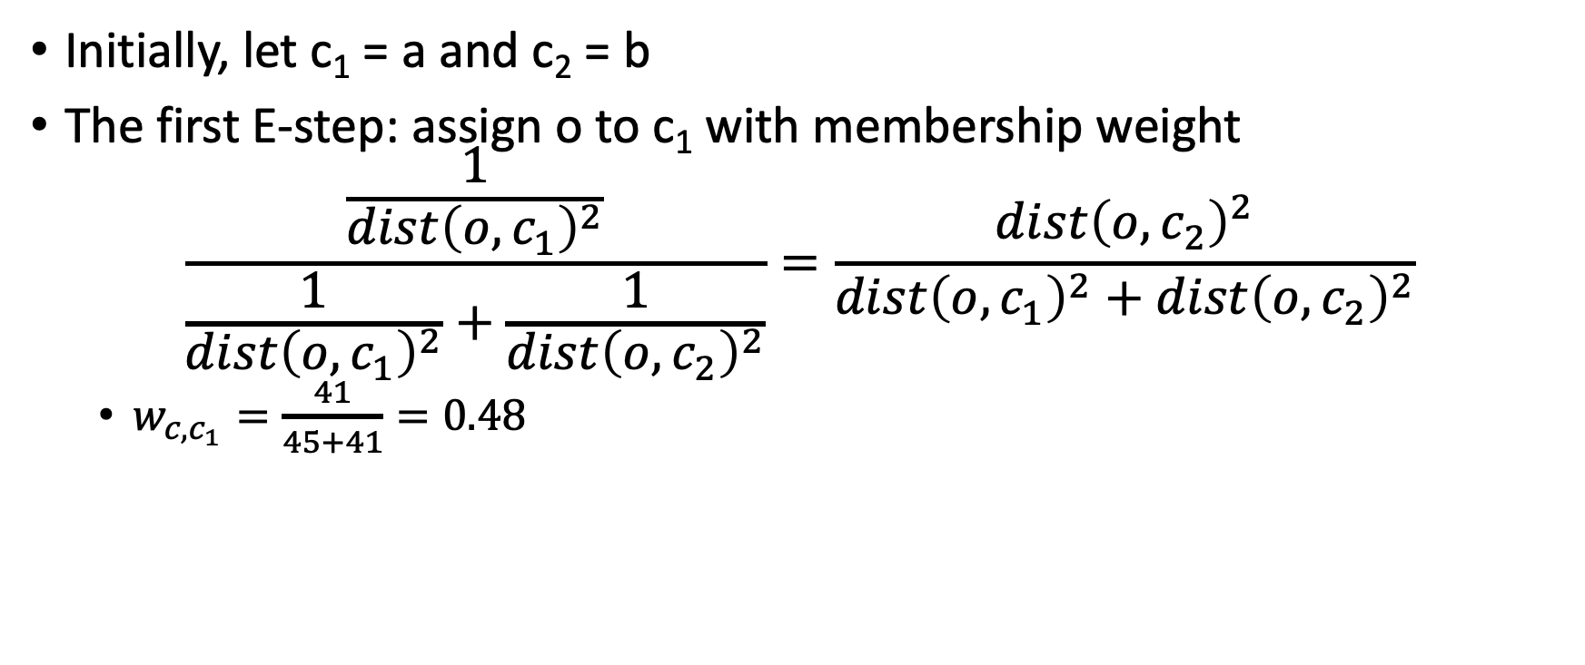
Fuzzy Clustering Using the EM Algorithm: Example
Initially, let c₁ = a and c₂ = b
The first E-step: assign o to c₁ with membership weight
$$\frac{\frac{1}{dist{\left(o,c_{1}\right)}^{2}}}{\frac{1}{dist{\left(o,c_{1}\right)}^{2}}+\frac{1}{dist{\left(o,c_{2}\right)}^{2}}}=\frac{dist{\left(o,c_{2}\right)}^{2}}{dist{\left(o,c_{1}\right)}^{2}+dist{\left(o,c_{2}\right)}^{2}}$$
$w_{c,c_{1}}=\frac{41}{45+41}=0.48$

Slide 14

Fuzzy Clustering Using the EM Algorithm: Example
The first M-step: recalculate the centroids according to the partition matrix, minimizing the sum of squared error (SSE)
$$c_{j}=\frac{\sum_{each point o}{w_{o,c_{j}}^{2}o}}{\sum_{each point o}{w_{o,c_{j}}^{2}}}$$
$c_{1}=(8.47, 5.12)$
Iteratively calculate this until the cluster centers converge or the change is small enough

Slide 15
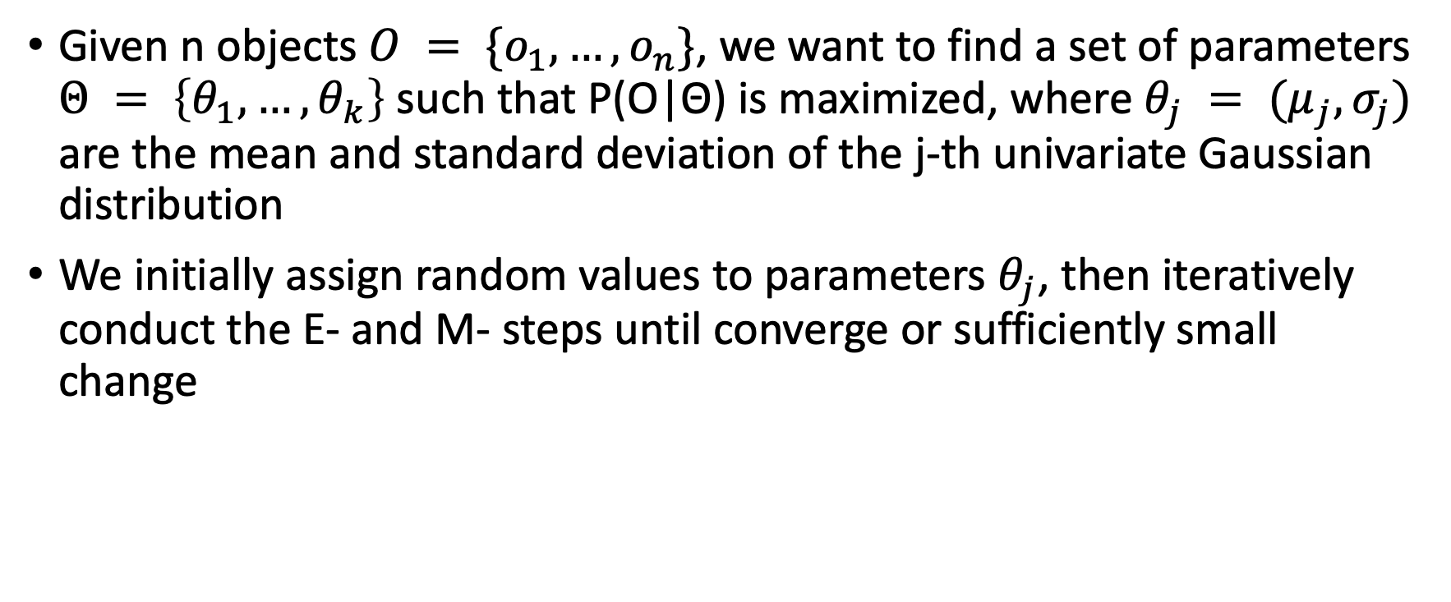
Computing Mixture Models with EM
Given n objects $O = \{o_{1}, …, o_{n}\}$, we want to find a set of parameters $Θ = \left\{θ_{1}, …, θ_{k}\right\}$ such that P(O|Θ) is maximized, where $θ_{j} = (μ_{j}, σ_{j})$ are the mean and standard deviation of the j-th univariate Gaussian distribution
We initially assign random values to parameters $θ_{j}$, then iteratively conduct the E- and M- steps until converge or sufficiently small change
Notes:
15

Slide 16
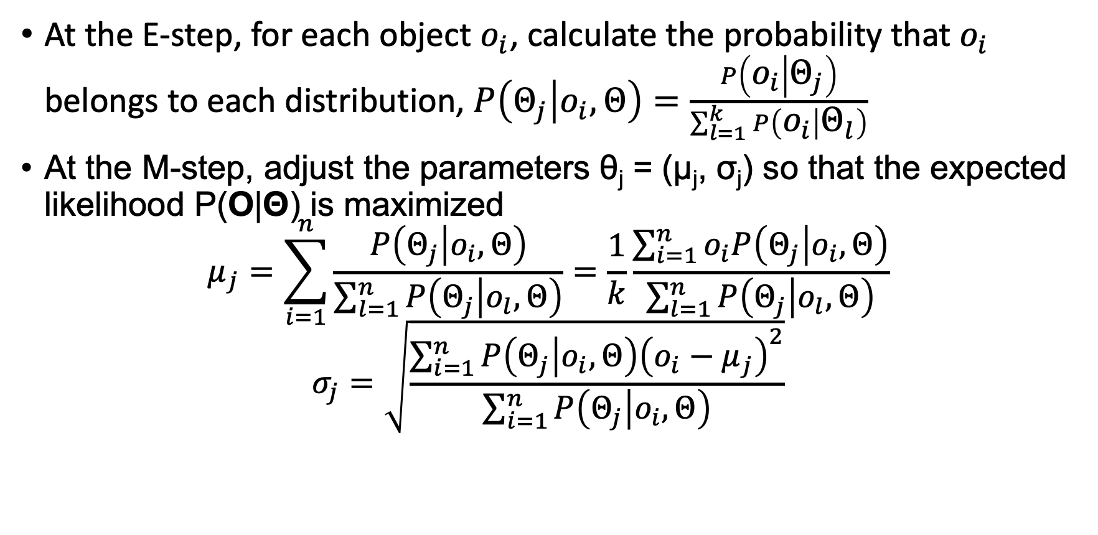
Computing Mixture Models with EM
At the E-step, for each object $o_{i}$, calculate the probability that $o_{i}$ belongs to each distribution, $P\left(Θ_{j} | o_{i},Θ\right)=\frac{P\left(o_{i} | Θ_{j}\right)}{\sum_{l=1}^{k}{P\left(o_{i} | Θ_{l}\right)}}$
At the M-step, adjust the parameters θ_{j} = (μ_{j}, σ_{j}) so that the expected likelihood P(O|Θ) is maximized
$$μ_{j}=\sum_{i=1}^{n}{\frac{P\left(Θ_{j} | o_{i},Θ\right)}{\sum_{l=1}^{n}{P\left(Θ_{j} | o_{l},Θ\right)}}=\frac{1}{k}\frac{\sum_{i=1}^{n}{o_{i}P\left(Θ_{j} | o_{i},Θ\right)}}{\sum_{l=1}^{n}{P\left(Θ_{j} | o_{l},Θ\right)}}}$$
$$σ_{j}=\sqrt{\frac{\sum_{i=1}^{n}{P\left(Θ_{j} | o_{i},Θ\right){\left(o_{i}−μ_{j}\right)}^{2}}}{\sum_{i=1}^{n}{P\left(Θ_{j} | o_{i},Θ\right)}}}$$
Notes:
16

Slide 17
Advantages and Disadvantages of Mixture Models
Strength
Mixture models are more general than partitioning and fuzzy clustering
Clusters can be characterized by a small number of parameters
The results may satisfy the statistical assumptions of the generative models
Weakness
Converge to local optimal (overcome: run multi-times with random initialization)
Computationally expensive if the number of distributions is large, or the data set contains very few observed data points
Need large data sets
Hard to estimate the number of clusters
17

Slide 18
Outline
Probabilistic model-based clustering
Clustering high-dimensional data
Why is clustering high-dimensional data challenging?
Axis-parallel subspace approaches
Arbitrarily oriented subspace approaches
Biclustering
Dimensionality reduction for clustering
Clustering graph and network data
Semisupervised clustering

Slide 19
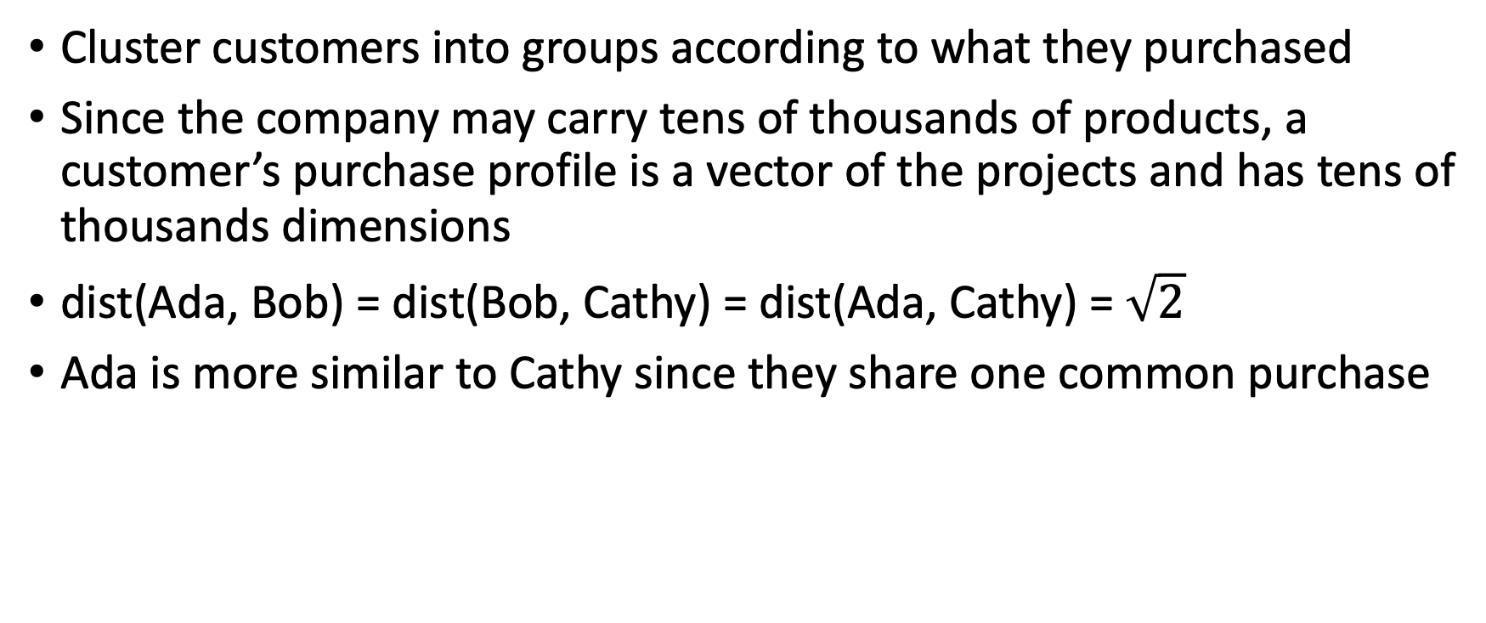
Motivation Example
Cluster customers into groups according to what they purchased
Since the company may carry tens of thousands of products, a customer’s purchase profile is a vector of the projects and has tens of thousands dimensions
dist(Ada, Bob) = dist(Bob, Cathy) = dist(Ada, Cathy) = $\sqrt{2}$
Ada is more similar to Cathy since they share one common purchase

Slide 20
Curse of Dimensionality
Many irrelevant or correlated attributes
Data sparsity
Distance concentration effect of similarity measures
Difficulty in optimization

Slide 21
High-dimensional Clustering Models
Clusters hidden in high-dimensional data are often significantly smaller and are manifested by a dramatically smaller subset of attributes
An essential principle in clustering high-dimensional data is to find clusters in subspaces
Finding clusters in axis-parallel versus arbitrarily oriented subspaces

Slide 22
Categorization of High-dimensional Clustering Methods
The clustering approaches: identify clusters in subspaces
The subspace clustering methods: find all clusters in all subspaces of the entire data space
The projected clustering methods: partition a given data set into non-overlapping subsets
The bi-clustering methods: cluster attributes and objects simultaneously
The dimensionality-reduction methods

Slide 23
Subspace Clustering: Subspace Search Methods
Search various subspaces to find clusters
Bottom-up approaches
Start from low-D subspaces and search higher-D subspaces only when there may be clusters in such subspaces
Various pruning techniques to reduce the number of higher-D subspaces to be searched
Ex. CLIQUE (Agrawal et al. 1998)
Top-down approaches
Start from full space and search smaller subspaces recursively
Effective only if the locality assumption holds: Restricts that the subspace of a cluster can be determined by the local neighborhood
Ex. PROCLUS (Aggarwal et al. 1999): A k-medoid-like method

Slide 24
Example of CLIQUE: Density and Grid-Based Subspace Clustering
Start at 1-D space and discretize numerical intervals in each axis into grid
Find dense regions in each subspace and generate their minimal descriptions (clusters)
Use the dense regions to find promising candidates in 2-D space (using Apriori principle)
CLIQUE automatically identifies subspaces of a high dimensional data space and terminates when no more clusters or cluster candidates can be found

Slide 25
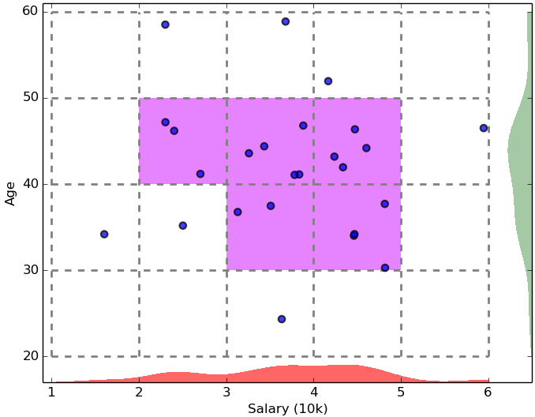
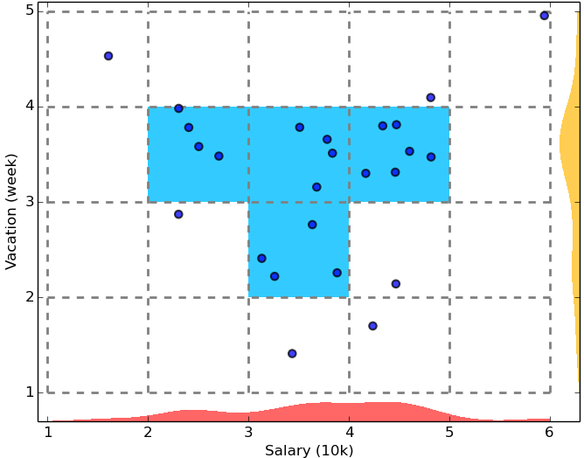
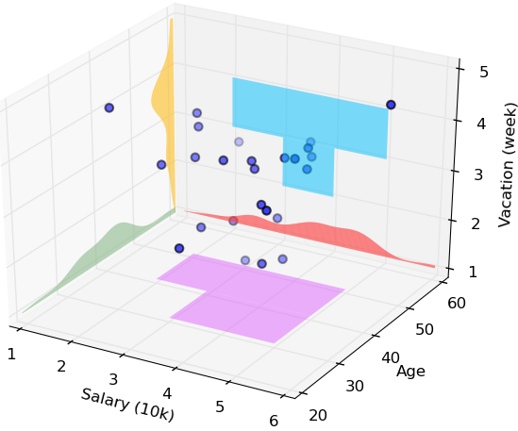
CLIQUE Illustration

Slide 26
PROCLUS: A Projected Clustering Method
A k-medoid-like method
Three phases
The initialization phase: generate k potential cluster centers using a greedy sample of the data set
The iterative phase: progressively improve the quality of the medoids
Find the attributes for each medoid
Form clusters
The refinement phase: adjust the subspaces of the clusters using only the data objects assigned to a cluster

Slide 27
Arbitrarily Oriented Subspace Approaches

Slide 28
Outline
Probabilistic model-based clustering
Clustering high-dimensional data
Biclustering
Why and where is biclustering useful?
Types of biclusters
Biclustering methods
Enumerating all biclusters using MaPle
Dimensionality reduction for clustering
Clustering graph and network data
Semisupervised clustering

Slide 29
Bi-Clustering Methods
Bi-clustering: Cluster both objects and attributes simultaneously (treat objects and attributes in a symmetric way)
Four requirements:
Only a small set of objects participate in a cluster
A cluster only involves a small number of attributes
An object may participate in multiple clusters, or does not participate in any cluster at all
An attribute may be involved in multiple clusters, or is not involved in any cluster at all

Slide 30
Bi-Clustering Methods
Example 1: Gene expression or microarray data: a gene sample/condition matrix.
Each element in the matrix, a real number, records the expression level of a gene under a specific condition
Example 2: Clustering customers and products
Another bi-clustering problem

Slide 31
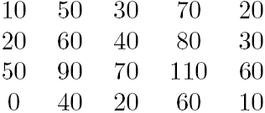
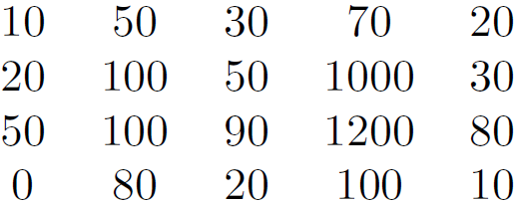
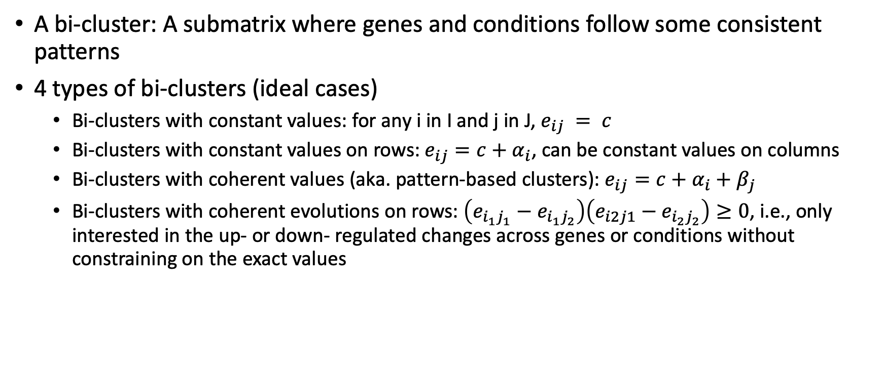
Types of Bi-clusters
A bi-cluster: A submatrix where genes and conditions follow some consistent patterns
4 types of bi-clusters (ideal cases)
Bi-clusters with constant values: for any i in I and j in J, $e_{ij} = c$
Bi-clusters with constant values on rows: $e_{ij}=c+α_{i}$, can be constant values on columns
Bi-clusters with coherent values (aka. pattern-based clusters): $e_{ij}=c+α_{i}+β_{j}$
Bi-clusters with coherent evolutions on rows: $\left(e_{i_{1}j_{1}}−e_{i_{1}j_{2}}\right)\left(e_{i2j1}−e_{i_{2}j_{2}}\right)≥0$, i.e., only interested in the up- or down- regulated changes across genes or conditions without constraining on the exact values
31

Slide 32
Bi-Clustering Methods
Real-world data is noisy: Try to find approximate bi-clusters
Methods: Optimization-based methods vs. enumeration methods
Optimization-based methods
Try to find a submatrix at a time that achieves the best significance as a bi-cluster
Due to the cost in computation, greedy search is employed to find local optimal bi-clusters
Ex. δ-Cluster Algorithm (Cheng and Church, ISMB’2000)
Enumeration methods
Use a tolerance threshold to specify the degree of noise allowed in the bi-clusters to be mined
Then try to enumerate all submatrices as bi-clusters that satisfy the requirements
Ex. δ-pCluster Algorithm (H. Wang et al.’ SIGMOD’2002, MaPle: Pei et al., ICDM’2003)
32

Slide 33
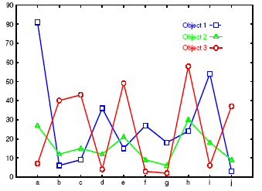
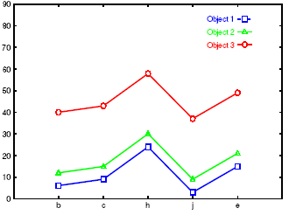
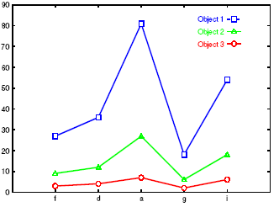
Bi-Clustering for Micro-Array Data Analysis
Left figure: Micro-array “raw” data shows 3 genes and their values in a multi-D space: Difficult to find their patterns
Right two: Some subsets of dimensions form nice shift and scaling patterns
No globally defined similarity/distance measure
Clusters may not be exclusive
An object can appear in multiple clusters
33
Notes:
33

Slide 34
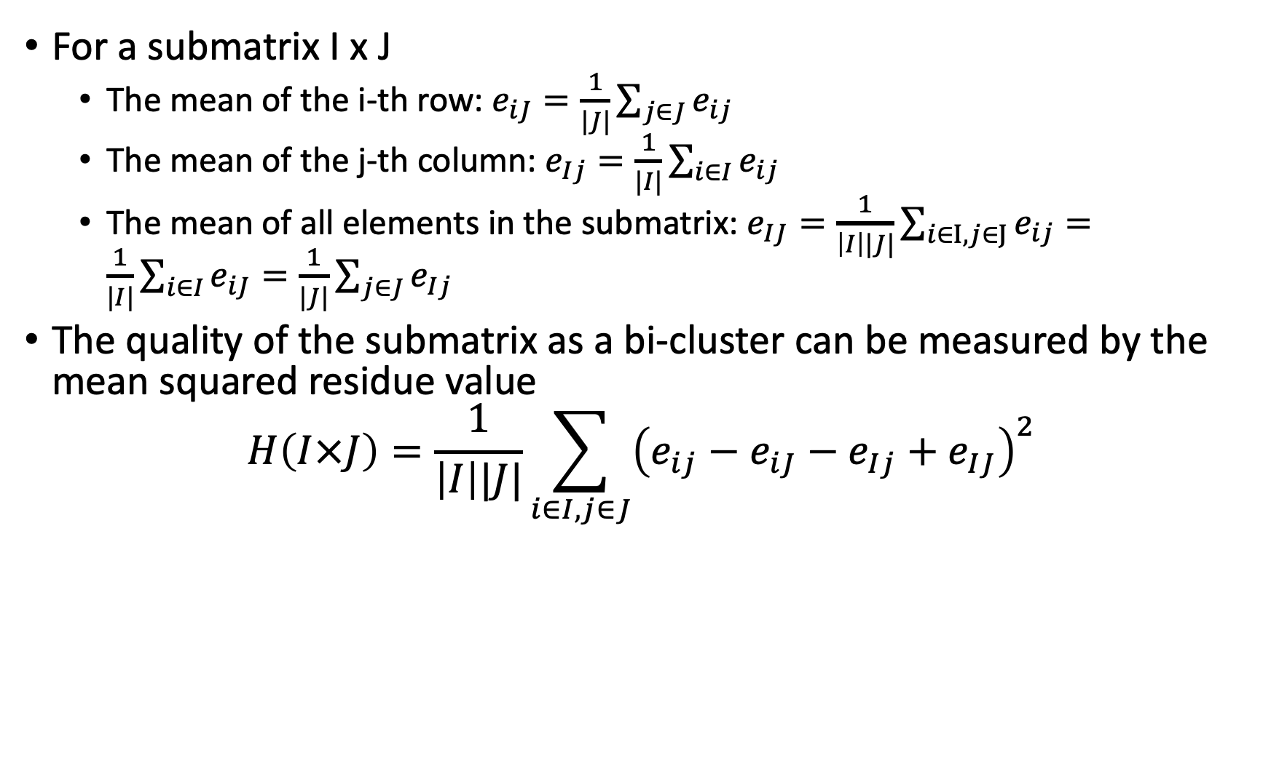
δ-Bi-Cluster
For a submatrix I x J
The mean of the i-th row: $e_{iJ}=\frac{1}{|J|}\sum_{j∈J}{e_{ij}}$
The mean of the j-th column: $e_{Ij}=\frac{1}{|I|}\sum_{i∈I}{e_{ij}}$
The mean of all elements in the submatrix: $e_{IJ}=\frac{1}{\left|I\right||J|}\sum_{i∈I,j∈J}{e_{ij}}=\frac{1}{|I|}\sum_{i∈I}{e_{iJ}}=\frac{1}{|J|}\sum_{j∈J}{e_{Ij}}$
The quality of the submatrix as a bi-cluster can be measured by the mean squared residue value
$$H\left(I×J\right)=\frac{1}{\left|I\right||J|}\sum_{i∈I,j∈J}{{\left(e_{ij}−e_{iJ}−e_{Ij}+e_{IJ}\right)}^{2}}$$
34

Slide 35
δ-Bi-Cluster
A submatrix I x J is δ-bi-cluster if H(I x J) ≤ δ where δ ≥ 0 is a threshold. When δ = 0, I x J is a perfect bi-cluster with coherent values. By setting δ > 0, a user can specify the tolerance of average noise per element against a perfect bi-cluster
residue(e_{ij}) = e_{ij} − e_{iJ} − e_{Ij} + e_{IJ}

Slide 36
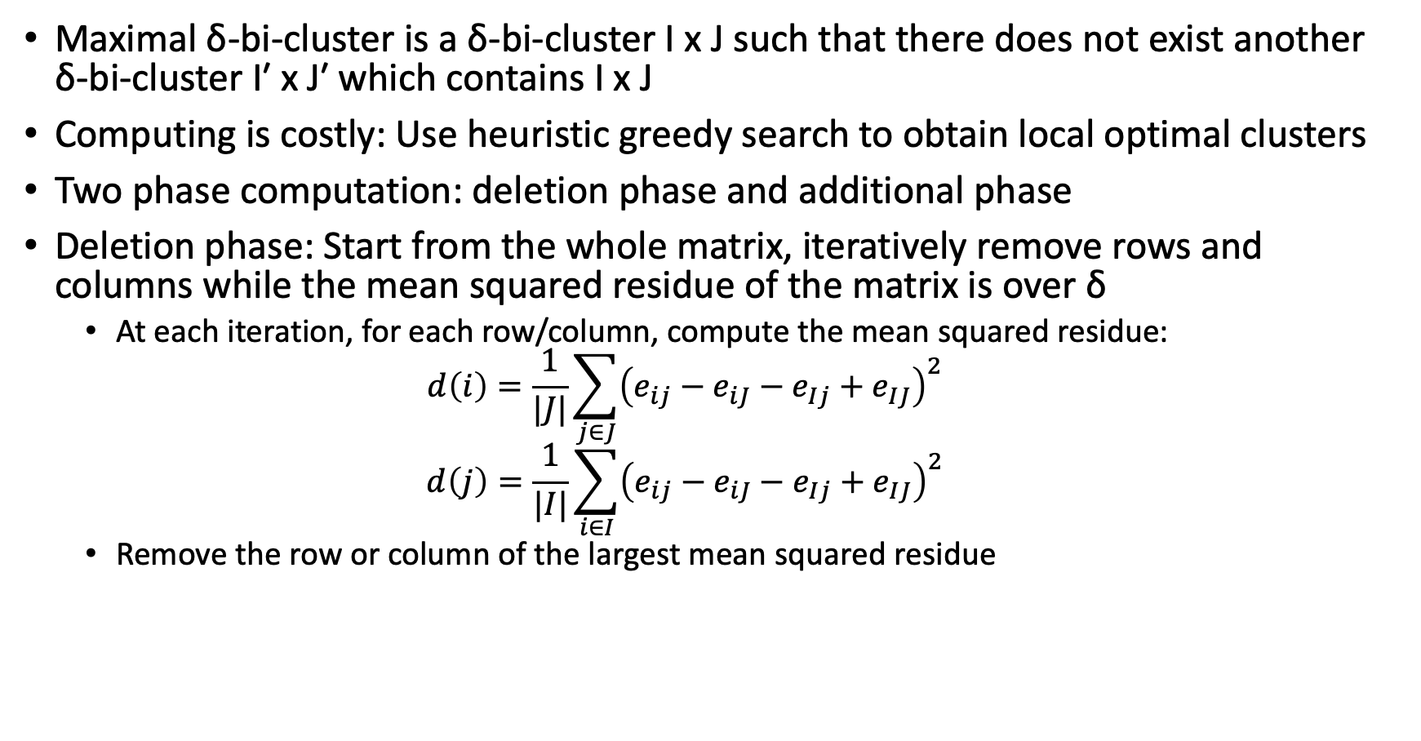
The δ-Cluster Algorithm
Maximal δ-bi-cluster is a δ-bi-cluster I x J such that there does not exist another δ-bi-cluster I′ x J′ which contains I x J
Computing is costly: Use heuristic greedy search to obtain local optimal clusters
Two phase computation: deletion phase and additional phase
Deletion phase: Start from the whole matrix, iteratively remove rows and columns while the mean squared residue of the matrix is over δ
At each iteration, for each row/column, compute the mean squared residue:
$$d\left(i\right)=\frac{1}{|J|}\sum_{j∈J}{{\left(e_{ij}−e_{iJ}−e_{Ij}+e_{IJ}\right)}^{2}}$$
$$d\left(j\right)=\frac{1}{|I|}\sum_{i∈I}{{\left(e_{ij}−e_{iJ}−e_{Ij}+e_{IJ}\right)}^{2}}$$
Remove the row or column of the largest mean squared residue
36

Slide 37
The δ-Cluster Algorithm
Addition phase:
Expand iteratively the δ-bi-cluster I x J obtained in the deletion phase as long as the δ-bi-cluster requirement is maintained
Consider all the rows/columns not involved in the current bi-cluster I x J by calculating their mean squared residues
A row/column of the smallest mean squared residue is added into the current δ-bi-cluster
It finds only one δ-bi-cluster, thus needs to run multiple times: replacing the elements in the output bi-cluster by random numbers

Slide 38
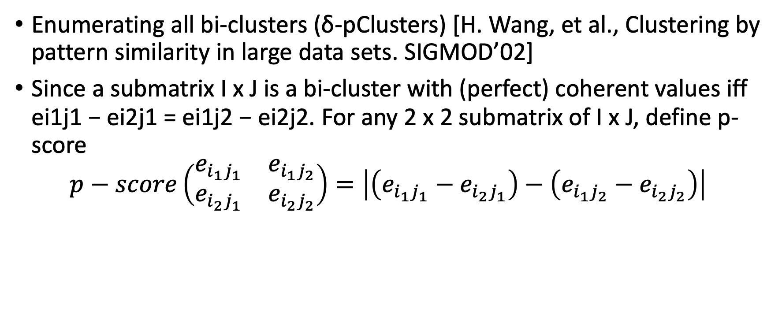
δ-pCluster
Enumerating all bi-clusters (δ-pClusters) [H. Wang, et al., Clustering by pattern similarity in large data sets. SIGMOD’02]
Since a submatrix I x J is a bi-cluster with (perfect) coherent values iff ei1j1 − ei2j1 = ei1j2 − ei2j2. For any 2 x 2 submatrix of I x J, define p-score
$$p−score\left(\begin{matrix}e_{i_{1}j_{1}} & e_{i_{1}j_{2}} \\ e_{i_{2}j_{1}} & e_{i_{2}j_{2}}\end{matrix}\right)=\left|\left(e_{i_{1}j_{1}}−e_{i_{2}j_{1}}\right)−\left(e_{i_{1}j_{2}}−e_{i_{2}j_{2}}\right)\right|$$
38

Slide 39
δ-pCluster
A submatrix I x J is a δ-pCluster (pattern-based cluster) if the p-score of every 2 x 2 submatrix of I x J is at most δ, where δ ≥ 0 is a threshold specifying a user's tolerance of noise against a perfect bi-cluster
The p-score controls the noise on every element in a bi-cluster, while the mean squared residue captures the average noise
Monotonicity: If I x J is a δ-pClusters, every x x y (x,y ≥ 2) submatrix of I x J is also a δ-pClusters.
A δ-pCluster is maximal if no more row or column can be added into the cluster and retain δ-pCluster: We only need to compute all maximal δ-pClusters.
39

Slide 40
MaPle: Efficient Enumeration of δ-pClusters
Pei et al., MaPle: Efficient enumerating all maximal δ-pClusters. ICDM'03
Framework: Same as pattern-growth in frequent pattern mining (based on the downward closure property)
For each condition combination J, find the maximal subsets of genes I such that I x J is a δ-pClusters
If I x J is not a submatrix of another δ-pClusters
then I x J is a maximal δ-pCluster
40

Slide 41
Outline
Probabilistic model-based clustering
Clustering high-dimensional data
Biclustering
Dimensionality reduction for clustering
Linear dimensionality reduction methods for clustering
Nonnegative matrix factorization (NMF)
Spectral clustering
Clustering graph and network data
Semisupervised clustering

Slide 42
Dimensionality-Reduction Methods
Dimensionality reduction: In some situations, it is more effective to construct a new space instead of using some subspaces of the original data
Example: to cluster the points in the figure, any subspace of the original one, X and Y, cannot help, since all the three clusters will be projected into the overlapping areas in X and Y axes
Construct a new dimension as the dashed one, the three clusters become apparent when the points projected into the new dimension
42

Slide 43
Dimensionality Reduction Methods
Feature selection and extraction: But may not focus on clustering structure finding
Non-negative matrix factorization (NMF): One high-D sparse nonnegative matrix factorizes approximately into two low-rank matrices
Spectral clustering: Uses the spectrum of the similarity matrix of the data to perform dimensionality reduction for clustering in fewer dimensions

Slide 44
High-Dimensional Clustering by Nonnegative Matrix Factorization (NMF)
Nonnegative matrix factorization (NMF)
A nonnegative matrix A_{n×d} (e.g., word frequencies in docs) can be approximately factorized into two non-negative low rank matrices U_{n×k} and V_{k×d} : A_{n×d} ≈ U_{n×k} V_{k×d} (or, A ≈ U V)
Residue matrix R represents the noise in the underlying data: R = A − U V
Constrained optimization: Determine U and V so that the sum of the square of the residuals in R is minimized
U and V simultaneously provide the clusters on the rows (docs) and columns (words). Thus it is another kind of co-clustering
U_{n×k} represents the components of each of n objects mapped into each of k newly created dimensions
V_{k×d} represents each of k newly created dimensions in terms of the original d dimensions (words)
Advantage: Intepretability of NMF—A data point can be expressed as a non-negative linear combination of the concepts in the underlying data

Slide 45
Spectral Clustering Methods
Spectral clustering methods use the spectrum of the similarity matrix of the data to perform dimensionality reduction for clustering in fewer dimensions
It combines feature extraction and clustering
Classical methods
Normalized Cuts (Shi and Malik, CVPR’97 or PAMI’2000)
The Ng-Jordan-Weiss algorithm (NIPS’01)
45

Slide 46

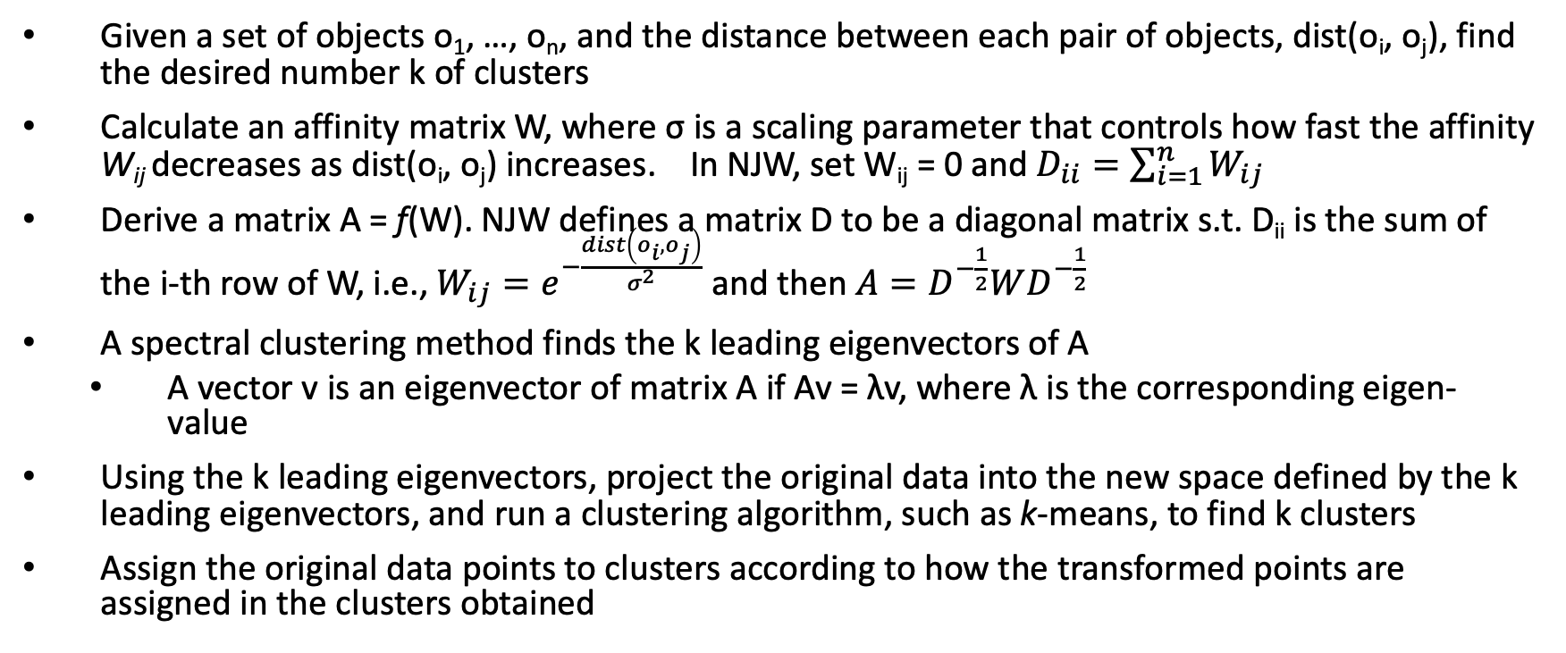
Spectral Clustering: The Ng-Jordan-Weiss (NJW) Algorithm
Given a set of objects o₁, …, o_{n}, and the distance between each pair of objects, dist(o_{i}, o_{j}), find the desired number k of clusters
Calculate an affinity matrix W, where σ is a scaling parameter that controls how fast the affinity W_{ij} decreases as dist(o_{i}, o_{j}) increases. In NJW, set W_{ij} = 0 and $D_{ii}=\sum_{i=1}^{n}{W_{ij}}$
Derive a matrix A = f(W). NJW defines a matrix D to be a diagonal matrix s.t. D_{ii} is the sum of the i-th row of W, i.e., $W_{ij}=e^{−\frac{dist\left(o_{i}, o_{j}\right)}{σ^{2}}}$ and then $A=D^{−\frac{1}{2}}WD^{−\frac{1}{2}}$
A spectral clustering method finds the k leading eigenvectors of A
A vector v is an eigenvector of matrix A if Av = λv, where λ is the corresponding eigen-value
Using the k leading eigenvectors, project the original data into the new space defined by the k leading eigenvectors, and run a clustering algorithm, such as k-means, to find k clusters
Assign the original data points to clusters according to how the transformed points are assigned in the clusters obtained
46

Slide 47
Spectral Clustering: Illustration and Comments
Spectral clustering: Effective in tasks like image processing
Scalability challenge: Computing eigenvectors on a large matrix is costly
Can be combined with other clustering methods, such as bi-clustering
47

Slide 48
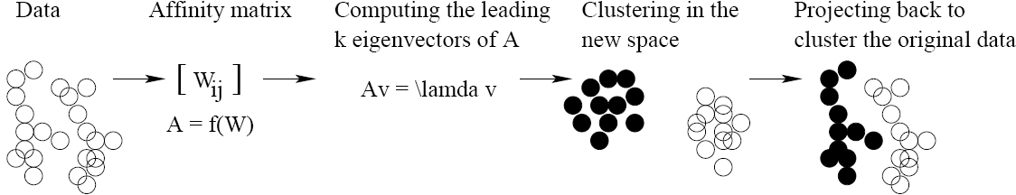
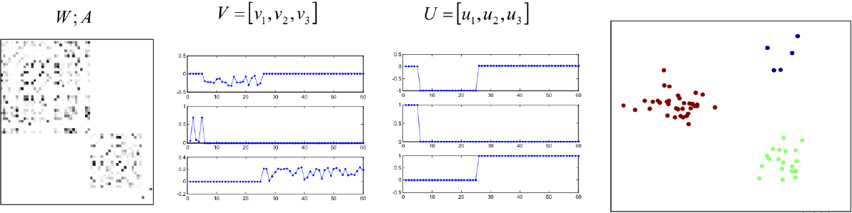
Spectral Clustering: Illustration and Comments
48

Slide 49
Outline
Probabilistic model-based clustering
Clustering high-dimensional data
Biclustering
Dimensionality reduction for clustering
Clustering graph and network data
Applications and challenges
Similarity measures
Graph clustering methods
Semisupervised clustering

Slide 50
Clustering Graphs and Network Data
Applications
Bi-partite graphs, e.g., customers and products, authors and conferences
Web search engines, e.g., click through graphs and Web graphs
Social networks, friendship/coauthor graphs
Similarity measures
Geodesic distances
Distance based on random walk (SimRank)
Graph clustering methods
Minimum cuts: FastModularity (Clauset, Newman & Moore, 2004)
Density-based clustering: SCAN (Xu et al., KDD’2007)
50

Slide 51
Similarity Measure (I): Geodesic Distance
Geodesic distance (A, B): length (i.e., # of edges) of the shortest path between A and B (if not connected, defined as infinite)
Eccentricity of v, eccen(v): The largest geodesic distance between v and any other vertex u ∈ V − {v}.
E.g., eccen(a) = eccen(b) = 2; eccen(c) = eccen(d) = eccen(e) = 3
Radius of graph G: The minimum eccentricity of all vertices, i.e., the distance between the “most central point” and the “farthest border”
r = min v∈V eccen(v)
E.g., radius (g) = 2
Diameter of graph G: The maximum eccentricity of all vertices, i.e., the largest distance between any pair of vertices in G
d = max v∈V eccen(v)
E.g., diameter (g) = 3
A peripheral vertex is a vertex that achieves the diameter.
E.g., Vertices c, d, and e are peripheral vertices
51

Slide 52
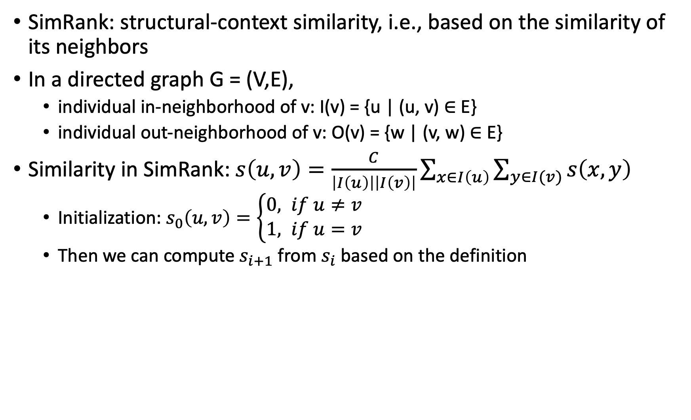
SimRank: Similarity Based on Random Walk and Structural Context
SimRank: structural-context similarity, i.e., based on the similarity of its neighbors
In a directed graph G = (V,E),
individual in-neighborhood of v: I(v) = {u | (u, v) ∈ E}
individual out-neighborhood of v: O(v) = {w | (v, w) ∈ E}
Similarity in SimRank: $s\left(u,v\right)=\frac{C}{\left|I\left(u\right)\right|\left|I\left(v\right)\right|}\sum_{x∈I\left(u\right)}{\sum_{y∈I(v)}{s\left(x,y\right)}}$
Initialization: $s_{0}\left(u,v\right)=\left\{\begin{aligned}0, if u≠v \\ &1, if u=v\end{aligned}\right.$
Then we can compute $s_{i+1}$ from $s_{i}$ based on the definition
52

Slide 53
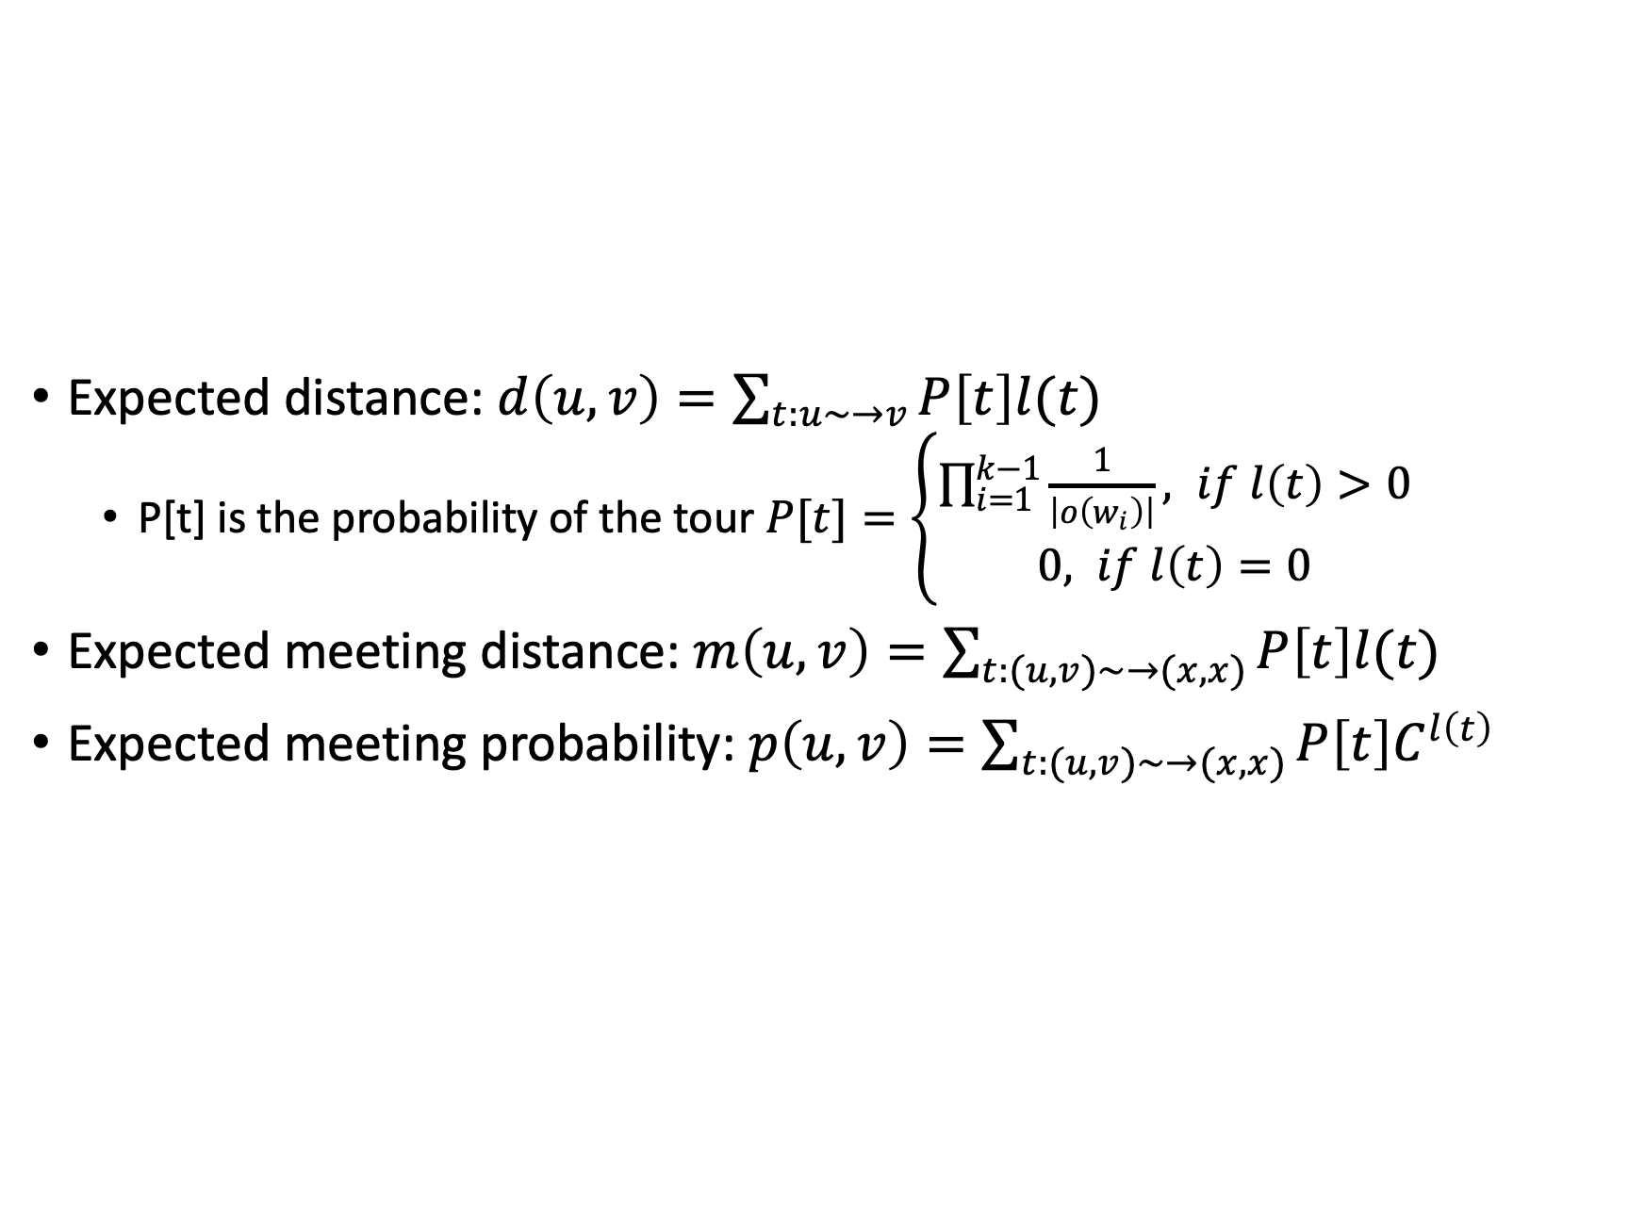
Similarity Based on Random Walk in a Strongly Connected Component
Expected distance: $d\left(u,v\right)=\sum_{t:u∼→v}{P\left[t\right]l(t)}$
P[t] is the probability of the tour $P[t]=\left\{\begin{aligned}\prod_{i=1}^{k−1}{\frac{1}{\left|o\left(w_{i}\right)\right|}}, if l\left(t\right)>0 \\ 0, if l\left(t\right)=0\end{aligned}\right.$
Expected meeting distance: $m\left(u,v\right)=\sum_{t:(u,v)∼→(x,x)}{P\left[t\right]l(t)}$
Expected meeting probability: $p\left(u,v\right)=\sum_{t:(u,v)∼→(x,x)}{P\left[t\right]C^{l\left(t\right)}}$
53

Slide 54
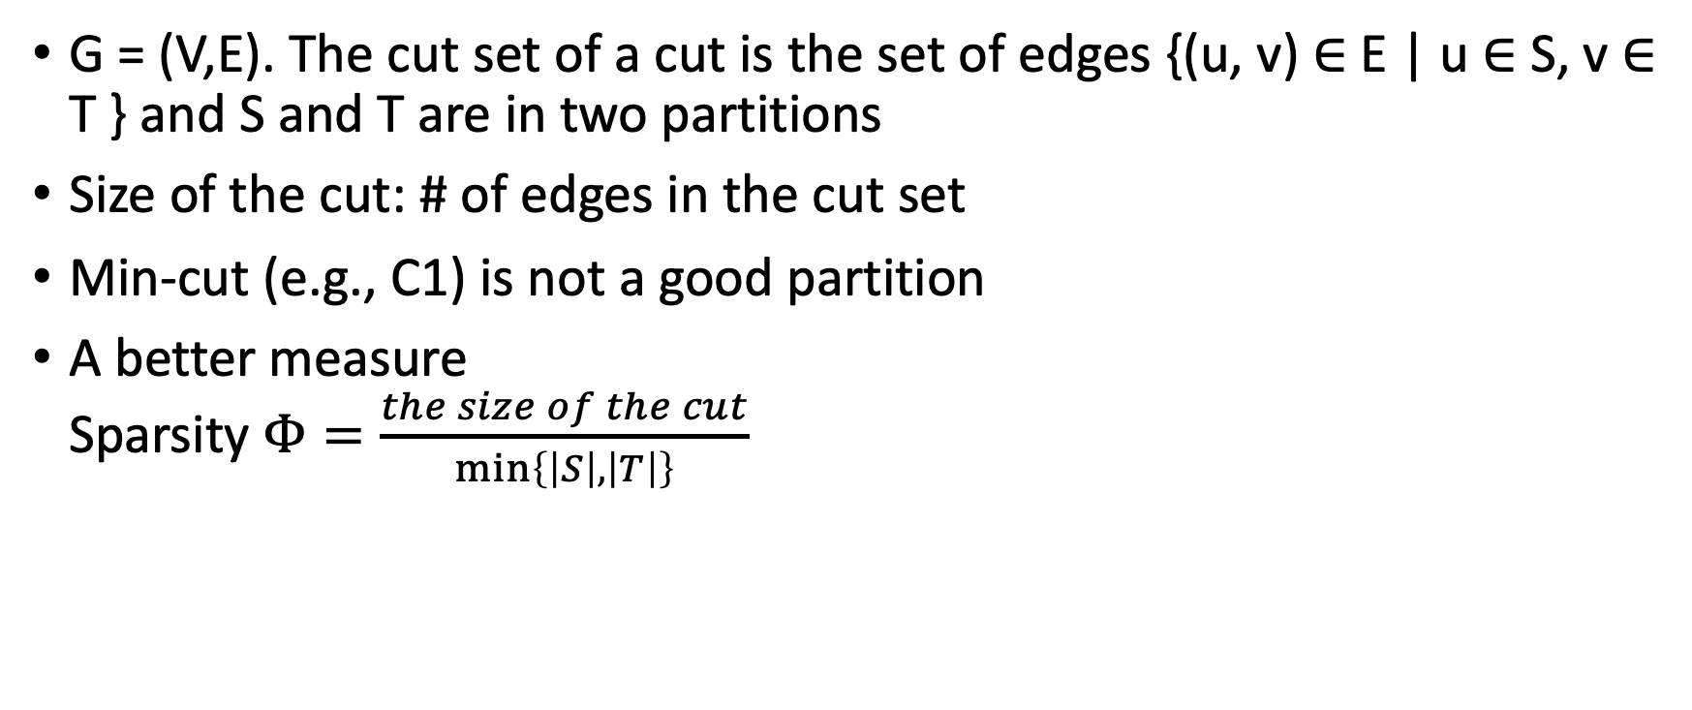
Graph Clustering: Sparsest Cut
G = (V,E). The cut set of a cut is the set of edges {(u, v) ∈ E | u ∈ S, v ∈ T } and S and T are in two partitions
Size of the cut: # of edges in the cut set
Min-cut (e.g., C1) is not a good partition
A better measure Sparsity $Φ=\frac{the size of the cut}{\min\left\{\left|S\right|,\left|T\right|\right\}}$
54

Slide 55

Graph Clustering: Sparsest Cut
A cut is sparsest if its sparsity is not greater than that of any other cut
Example: cut C2 = ({a, b, c, d, e, f, l}, {g, h, i, j, k}) is the sparsest cut
For k clusters, the modularity of a clustering assesses the quality of the clustering: $Q=\sum_{i=1}^{k}{\left(\frac{l_{i}}{\left|E\right|}−{\left(\frac{d_{i}}{2\left|E\right|}\right)}^{2}\right)}$
l_{i} is the number of edges between vertices in the i-th cluster, and d_{i} is the sum of the degrees of the vertices in the i-th cluster
The modularity of a clustering of a graph is the difference between the fraction of all edges that fall into individual clusters and the fraction that would do so if the graph vertices were randomly connected
The optimal clustering of graphs maximizes the modularity
55

Slide 56
Graph Clustering: Challenges of Finding Good Cuts
High computational cost
Many graph cut problems are computationally expensive
The sparsest cut problem is NP-hard
Need to tradeoff between efficiency/scalability and quality
Sophisticated graphs
May involve weights and/or cycles.
High dimensionality
A graph can have many vertices. In a similarity matrix, a vertex is represented as a vector (a row in the matrix) whose dimensionality is the number of vertices in the graph
Sparsity
A large graph is often sparse, meaning each vertex on average connects to only a small number of other vertices
A similarity matrix from a large sparse graph can also be sparse
56

Slide 57
Two Approaches for Graph Clustering
Two approaches for clustering graph data
Use generic clustering methods for high-dimensional data
Designed specifically for clustering graphs
Using clustering methods for high-dimensional data
Extract a similarity matrix from a graph using a similarity measure
A generic clustering method can then be applied on the similarity matrix to discover clusters
Ex. Spectral clustering: approximate optimal graph cut solutions
Methods specific to graphs
Search the graph to find well-connected components as clusters
Ex. SCAN (Structural Clustering Algorithm for Networks)
X. Xu, N. Yuruk, Z. Feng, and T. A. J. Schweiger, “SCAN: A Structural Clustering Algorithm for Networks”, KDD'07
57

Slide 58
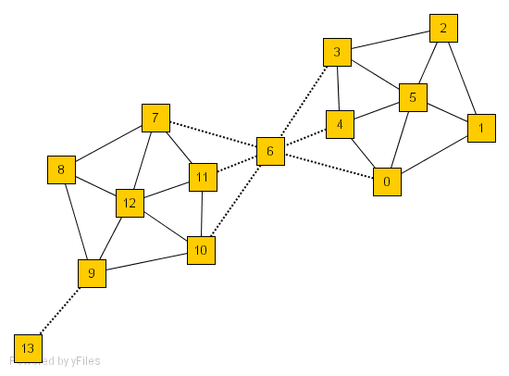
SCAN: Density-Based Clustering of Networks
Application: Given simply information of who associates with whom, could one identify clusters of individuals with common interests or special relationships (families, cliques, terrorist cells)?
How many clusters?
What size should they be?
What is the best partitioning?
Should some points be segregated?
An Example Network

Slide 59
A Social Network Model
Cliques, hubs and outliers
Individuals in a tight social group, or clique, know many of the same people, regardless of the size of the group
Individuals who are hubs know many people in different groups but belong to no single group. Politicians, for example bridge multiple groups
Individuals who are outliers reside at the margins of society. Hermits, for example, know few people and belong to no group
The Neighborhood of a Vertex
Define Γ(ν) as the immediate neighborhood of a vertex (i.e. the set of people that an individual knows)
59

Slide 60

Structure Similarity
The desired features tend to be captured by a measure we call Structural Similarity $σ\left(v,w\right)=\frac{\left|Γ\left(v\right)∩Γ\left(w\right)\right|}{\sqrt{\left|Γ\left(v\right)\right||Γ\left(w\right)|}}$
Structural similarity is large for members of a clique and small for hubs and outliers
60

Slide 61
Outline
Probabilistic model-based clustering
Clustering high-dimensional data
Biclustering
Dimensionality reduction for clustering
Clustering graph and network data
Semisupervised clustering
Semisupervised clustering on partially labeled data
Semisupervised clustering on pairwise constraints
Other types of background knowledge for semisupervised clustering

Slide 62
Clustering with Partially Labeled Data
Example: building a malware detector
Data
A large number of images of host systems
A small number of labeled images into two categories: malware and benign
Using only the labeled data to build a classifier may not be reliable and does not take the full advantage of all data
Semisupervised clustering approaches assume some domain knowledge is available

Slide 63
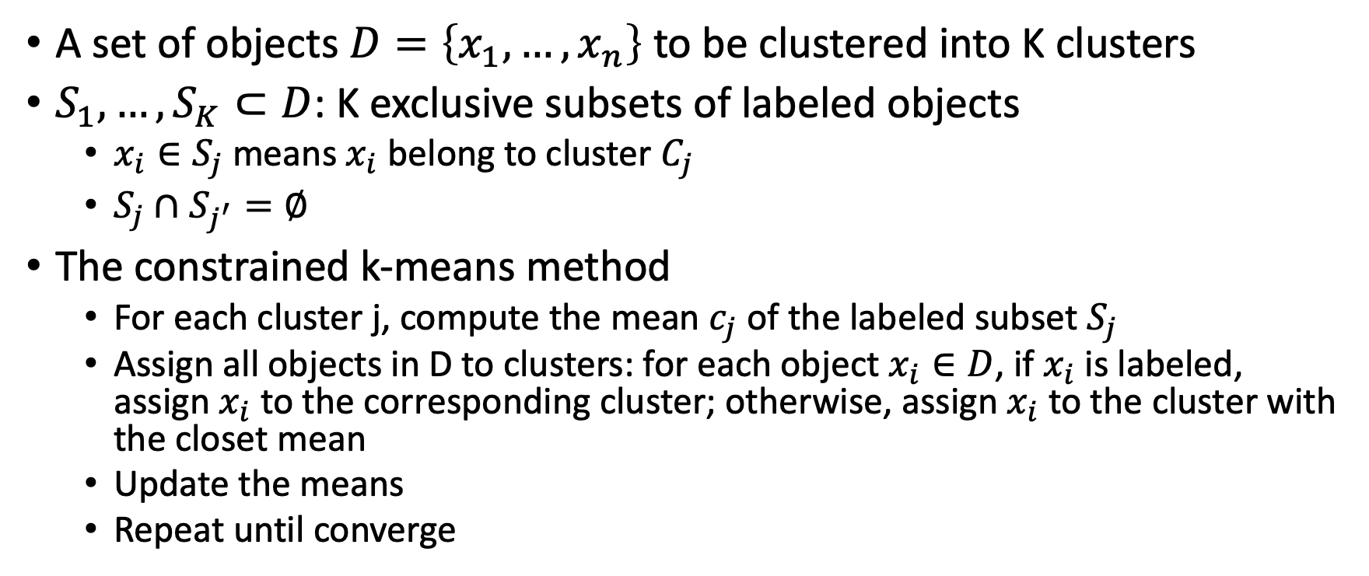
Semisupervised Clustering on Partially Labeled Data
A set of objects $D=\left\{x_{1},…,x_{n}\right\}$ to be clustered into K clusters
$S_{1},…,S_{K}⊂D$: K exclusive subsets of labeled objects
$x_{i}∈S_{j}$ means $x_{i}$ belong to cluster $C_{j}$
$S_{j}∩S_{j^{′}}=∅$
The constrained k-means method
For each cluster j, compute the mean $c_{j}$ of the labeled subset $S_{j}$
Assign all objects in D to clusters: for each object $x_{i}∈D$, if $x_{i}$ is labeled, assign $x_{i}$ to the corresponding cluster; otherwise, assign $x_{i}$ to the cluster with the closet mean
Update the means
Repeat until converge

Slide 64
Pairwise Constraints
Must-link constraints: two objects x and y should be grouped into one cluster in the output
Cannot-link constraints: two objects x and y should belong to different clusters in the output

Slide 65
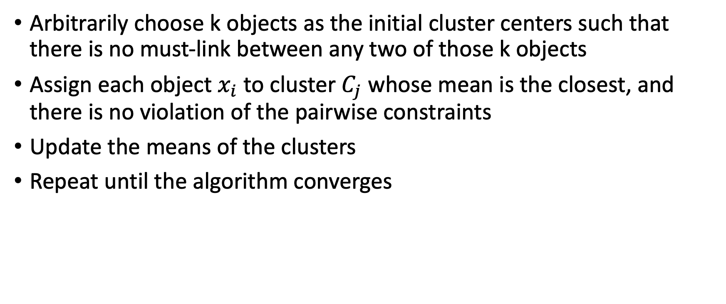
The COP-k-Means Algorithm
Arbitrarily choose k objects as the initial cluster centers such that there is no must-link between any two of those k objects
Assign each object $x_{i}$ to cluster $C_{j}$ whose mean is the closest, and there is no violation of the pairwise constraints
Update the means of the clusters
Repeat until the algorithm converges

Slide 66
Other Types of Background Knowledge for Semisupervised Clustering
Semisupervised hierarchical clustering
Clusters associated with outcome variables
Active and interactive learning for semisupervised clustering

